Slide 1



Project Sky Asia tours
Vivekanada chary kasarla
vivekkasarla27@gmail.com
8686018397
Project Sky Asia tours
“Explore the Unforgettable Adventures in subcontinent”
“Explore the Unforgettable Adventures in subcontinent”

Slide 2

our
JOURNEY
Introduction
Objectives
Seo strategy
0n page SEO
Off-page SEO
Keyword research
Short tail
Long tail
Website architecture
Home page navigation
url’S design
Short tail
Long tail
Meta title and description
Gallery
Internal link building
Press release
Guest blogging
Inbound link building

Slide 3
Introduction
Sky Asia Tours is a one of the fast growing travel company which Established in 1995. Today Sky Asia has created a name for itself among inbound tour operators in India.
They have expanded Their services into wide horizon of Tourism which gives new kind of experience to their clints, which includes,
leisure tours
unique experiences
luxury travel
Sky Asia majorly operating its business in subcontinent of Asia that is with offices in India, Bhutan and Nepal.

Slide 4
Objectives
Even though haven good website is not enough but it should also continuously engage there niche customers then it will become successful website which brings potential customers to its business
To archive that we should develop a comprehensive SEO strategy to make Sky Asia tours as a undisputed leader when it comes to tours & travels in Indian subcontinent.
Which includes:-
Publishing various articles in its blog about travel and tourism (like top 10 travel destinations in Indian subcontinent )
Improving search engine ranking for there website
Conducting extensive keyword research to get ranked on multiple keywords
Maximizing conversions from organic search traffic

Slide 5

Our SEO strategy
We follow these steps as a part of our SEO strategy:
On page SEO
Identifying protentional Keywords
Writing blogs around that keywords
Building eye caching URL’s using those Keywords
Writing attractive meta title and title description
Optimizing website with good looking images
Creating internal links through making inter dependable content

Slide 6
Off-page optimization
Promoting our website through online press release
Doing guest blogging
Creating back links (inbound) to our website from other domains

Slide 7
Keyword Research
Short tail keywords:
1. honeymoon packages
2. pilgrimage
3. luxury travel
4. Discover India
5. Bharath darshan
6. Road trip
7.Resorts
8. Heritage travel
9. adventure trip
10. tour guide
11. trip planner
Long tail Keywords:
best places to visit in June in India(Jan/Feb.)
destination wedding packages
destination wedding cost
Honeymoon
places to visit in summer in India(winter, spring)
best visiting places in Delhi (Kerala, Mumbai)
holiday packages in India
solo trip in India
holiday destinations in India
chota char dham

Slide 8
Website Architecture
Home page
Main menu
tours
Theme
Packages
Blog
FAQ’s
Top destination
offers
National international
South India
North India
North East India
Goa
Shimla
Delhi
Hyderabad
Agra
Wild life
Adventure
pilgrimage
Honeymoon packages
Wedding packages
Pilgrimage packages
Best pleases to visit
Nepal
Srilanka
Bhutan

Slide 9
Home Navigation
Home page of our website is starts with our logo then will place a search engine beside that will place our login form
Below our logo will design an travel planner, after submitting it, it will populate suggestions in that destination
Below this will show our top offerings
Last will place rating and reviews given by customers
Starts from: Hyderabad
Destination: goa
Duration: 3 days
Budget: 50K

Slide 10
URL’s Design
Short tail URL’s
https://www.skyasiatours.com/trip-planner
https://www.skyasiatours.com/packages/honeymoon
https://www.skyasiatours.com/packages/pilgrimage
https://www.skyasiatours.com/packages/luxury-travel
https://www.skyasiatours.com/hotel/goa/marriott
https://www.skyasiatours.com/packages/Bharath-darshan
https://www.skyasiatours.com/packages/Road-trip
https://www.skyasiatours.com/Resorts
https://www.skyasiatours.com/packages/heritage travel
https://www.skyasiatours.com/packages/adventure trip

Slide 11
LONG-TAIL-KEYWORD-URL’s
https://www.skyasiatours.com/tour-guide/places-to-visit-in-India/jan
https://www.skyasiatours.com/tour-guide/places-to-visit-in-India/spring
https://www.skyasiatours.com/tour-guide/Discover-India/panjab
https://www.skyasiatours.com/tour-guide/wild-life
https://www.skyasiatours.com/packages/solo-trip-in-India
https://www.skyasiatours.com/ packages/destination-wedding
https://www.skyasiatours.com/tour-guide/chota-char-dham
https://www.skyasiatours.com/tour-guide/india/holiday-destinations
https://www.skyasiatours.com/tour-guide/india/honeymoon-destinations
https://www.skyasiatours.com/tour-guide/ places-to-visit-in-India/historical
“here travel guide mainly serve as our blog page which helps people to know more about places they are going to visit”

Slide 12
Meta title and description
Short-tail URL’s
1. Make Your Trip Memorable \trip planner- sky Asia tours
Plan your dream Indian subcontinent vacation with Sky Asia Tours. Our trip planner helps you find the best packages and experiences for your trip.
2. Explore Honeymoon Packages with us- Sky Asia Tours
Celebrate your special day with a romantic honeymoon in India, Nepal, Bhutan, and other countries in the subcontinent. Check out Sky Asia Tours' honeymoon packages.
3. Explore Pilgrimage- sky Asia tours
Find spiritual fulfillment in the subcontinent with Sky Asia Tours' pilgrimage packages. Explore the ancient temples and sacred sites of India
4. Enjoy Luxury Travel with Sky Asia Tours
Enjoy a luxurious trip to India, Nepal, Bhutan, and other countries in the subcontinent with Sky Asia Tours' luxury travel packages.
5. enjoy the fine hospitality at your destination- Sky Asia Tours
Relax in the beautiful beachfront of Goa with Sky Asia Tours' Marriott hotels. Enjoy the best of both worlds with luxury and comfort.

Slide 13
6. Experience Bharath Darshan with Sky Asia Tours
visit India's most famous tourist attractions with Sky Asia Tours' Bharath Darshan packages. Explore the country's rich culture and traditions.
7. Road Trip Packages - Sky Asia Tours
Take a thrilling road trip across India and its neighboring countries with Sky Asia Tours' road trip packages. Enjoy unforgettable experiences.
8. Explore top Resorts with Sky Asia Tours
Find the perfect place to relax and unwind in the subcontinent with Sky Asia Tours' resorts. Enjoy all the luxury and comfort that you deserve.
9. Discover India's rich heritage- Sky Asia Tours
Discover India's rich heritage with Sky Asia Tours' heritage travel packages. Explore the country's ancient monuments, temples, and architecture.
10. Add adventure to your life with sky Asia tours
Go on an exciting adventure through India and its neighboring countries with Sky Asia Tours' adventure trip packages. Experience the best of the subcontinent.

Slide 14
Meta title and description
Long-tail keywords
1.top 10 places to visit in India in January 2023
India is known for its diverse culture and vibrant colors. From the majestic Taj Mahal to the beautiful backwaters of Kerala, there are plenty of mesmerizing places to explore
2. 10 best places to visit in India in spring season
In the springtime, India comes alive with vibrant colors and mesmerizing beauty. From the captivating backwaters of Kerala to the tranquil hills of Darjeeling, there are plenty of places to explore
3. places you must visit in your trip to Punjab 2023
Punjab is a beautiful and vibrant state of India known for its rich culture and heritage. It is the land of five rivers and is a great place to explore. From lush green fields to beautiful historical monuments, the state has a lot to offer to its visitors.
4. 10 sensational places to explore the wild-life in India 2023
India is home to some of the most amazing wildlife in the world. From the majestic tigers of Ranthambore National Park to the exotic birds of Bharatpur, there are plenty of sensational places to explore the wild-life in India
5. explore the inner soul with best solo trip package with sky Asia
India is a great destination for solo travelers, with plenty of places to explore. From the hills of Leh-Ladakh to the tranquil beaches of Goa, there are plenty of options for a memorable solo trip. Take a spiritual journey to Varanasi and explore the ancient temples.

Slide 15
6. enjoy the all new destination wedding packages 2023 from sky Asia
Planning a destination wedding in India in 2023? Look no further explore our all new destination wedding packages. Choose from a variety of stunning venues in breathtaking locations across the country. From a romantic beach wedding in Goa to explore the vibrant city of Jaipur. Have a traditional wedding in Amritsar to the majestic hills of Darjeeling.
7. a complete travel guide to Chhota char dam- sky Asia tours
Are you planning for atrip to chota char dam here is the complete guide to plan your spiritual trip, it is one of the most popular pilgrimage destinations in India. Consisting of four ancient temples at Yamunotri, Gangotri, Kedarnath and Badrinath. A visit to Chhota Char Dham is sure to provide a spiritual experience of a lifetime
8. top 10 holiday destinations in India-sky Asia tours
Explore the majestic Taj Mahal in Agra and experience the vibrant nightlife in Mumbai. Take a spiritual journey to Varanasi and explore the ancient ruins of Hampi. Enjoy a romantic beach wedding in Goa and explore the colorful streets of Jaipur to sun rise in north east
9. best honeymoon places in India- sky Asia tours
A honeymoon destination has to be very special to celebrate the beginning of a new life together. From hills to beaches, India has many romantic places where a honeymoon couple can relax, enjoy and get to know each other. India has the some of the perfect destination for a lovely honeymoon.
10. top 10 historical monuments in India 2023
India is the home for the ancient living cavillations in the word and india is known for its rich and vibrant culture. From pre historical places like Dwarka to recently built ayodya. From Konark surya deva temple to raja raja Narendra’s mahabaleshwar temple

Slide 16

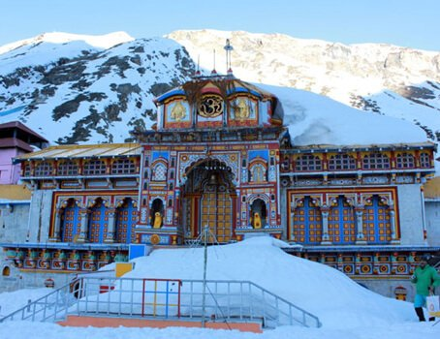
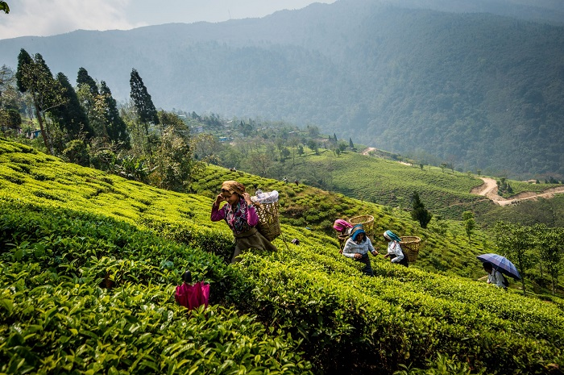
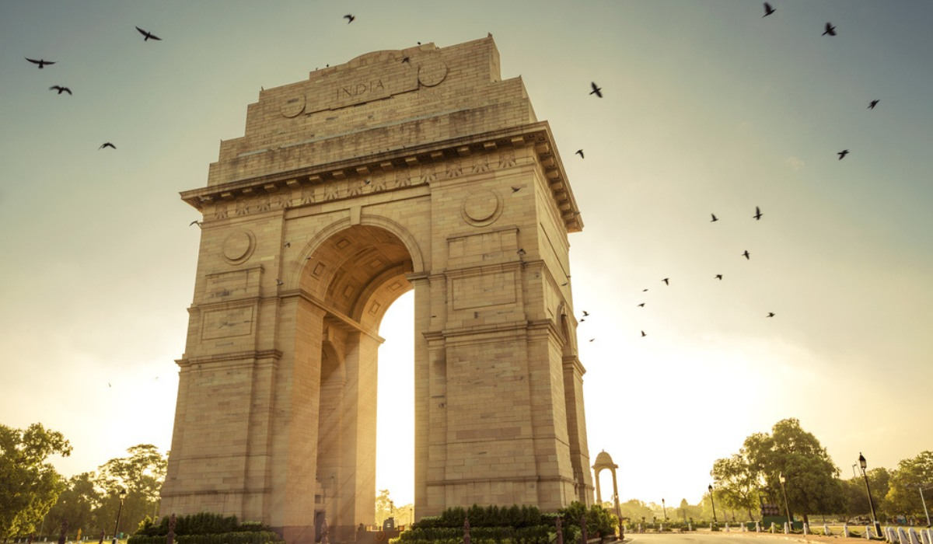
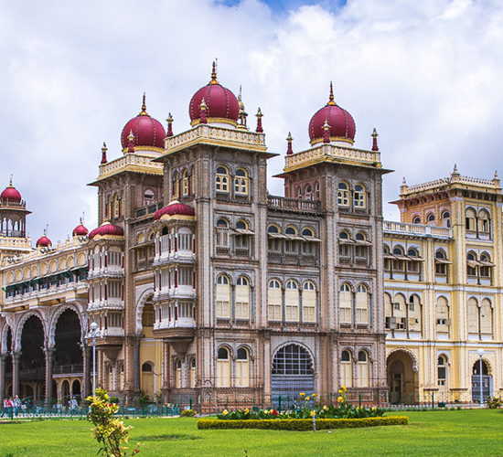
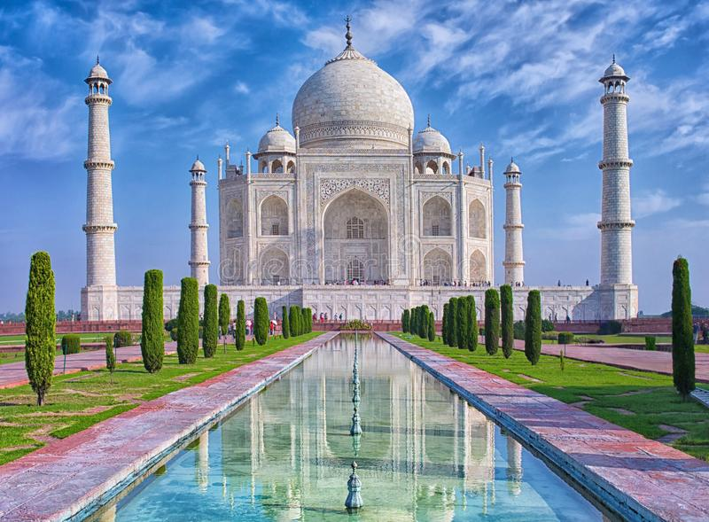
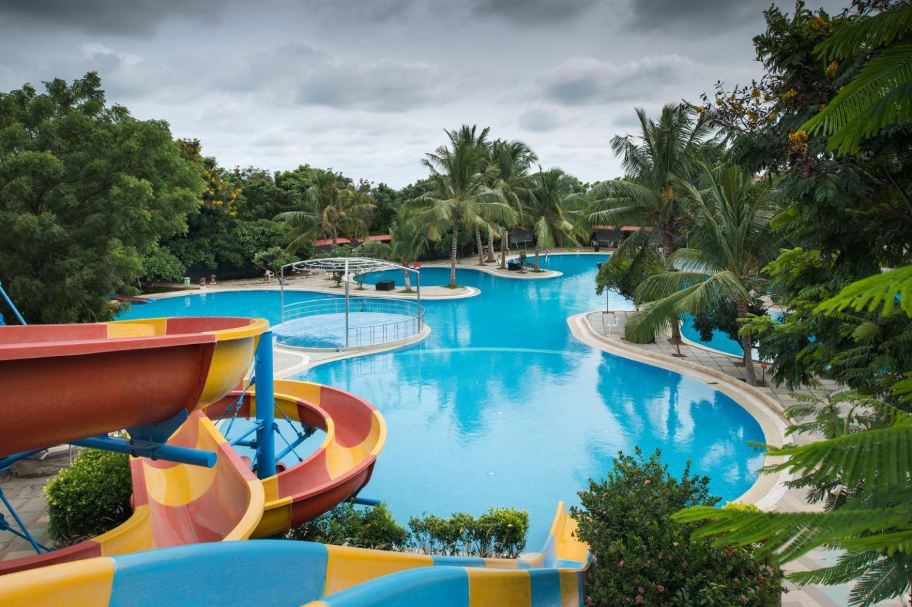
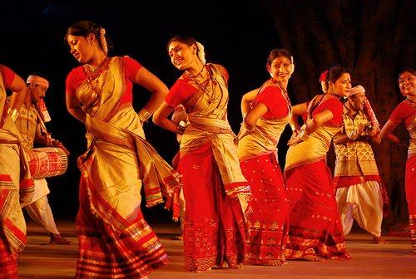
India gate, Delhi
Badrinath temple
Dudhsagar Waterfalls, goa
Darjeeling tea estates
Leonia resorts, Hyderabad
Taj mahal
Bihu dance
Mysore place, Karnataka

Slide 17
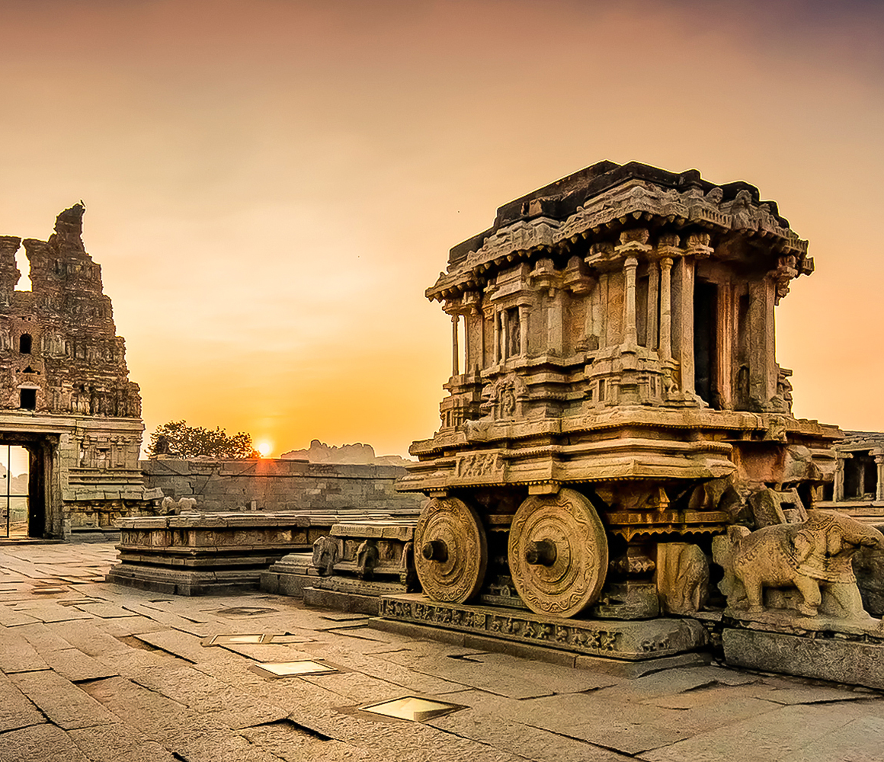

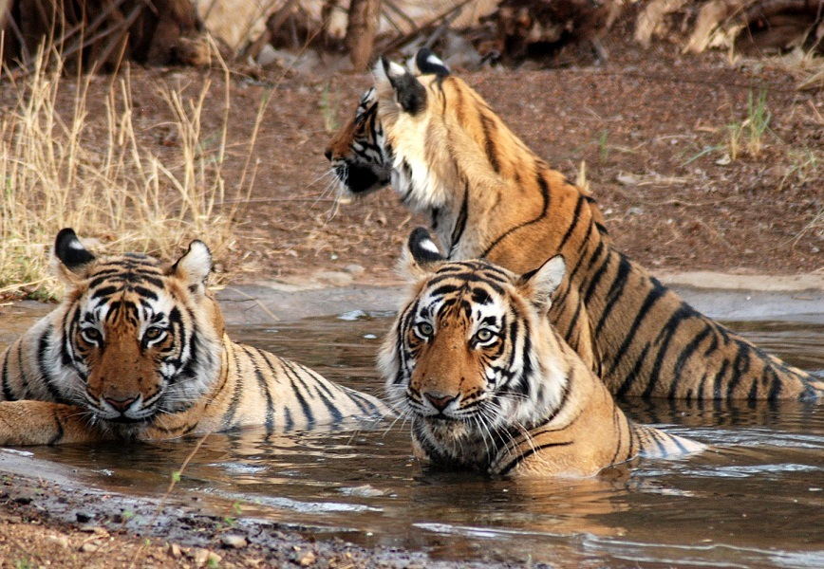

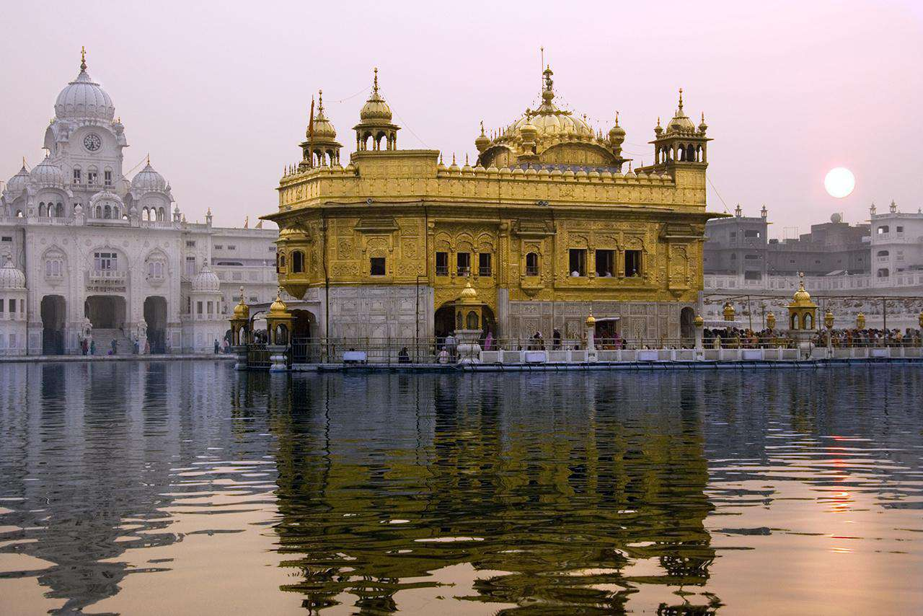

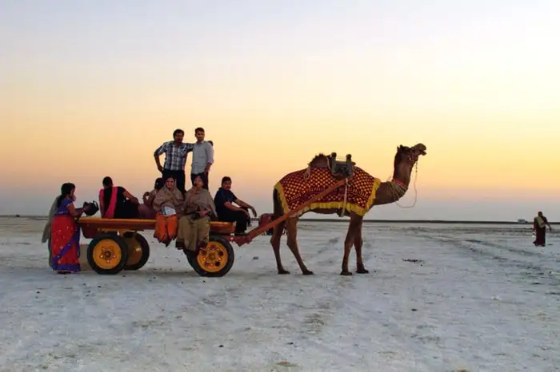
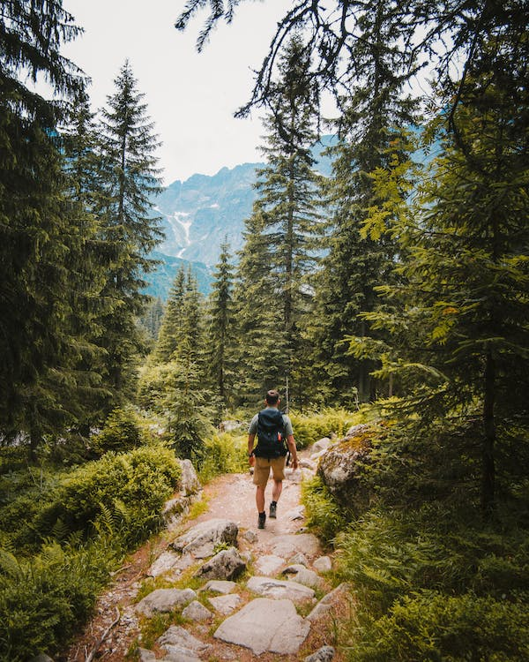
Hotel marotte
Road trip
Hampi Karnataka
Ranthambore
Thar, Rajasthan
Camping in Himalayas
Nature trip
Golden temple, Punjab

Slide 18
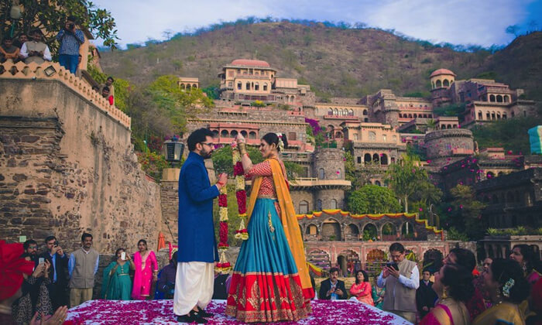
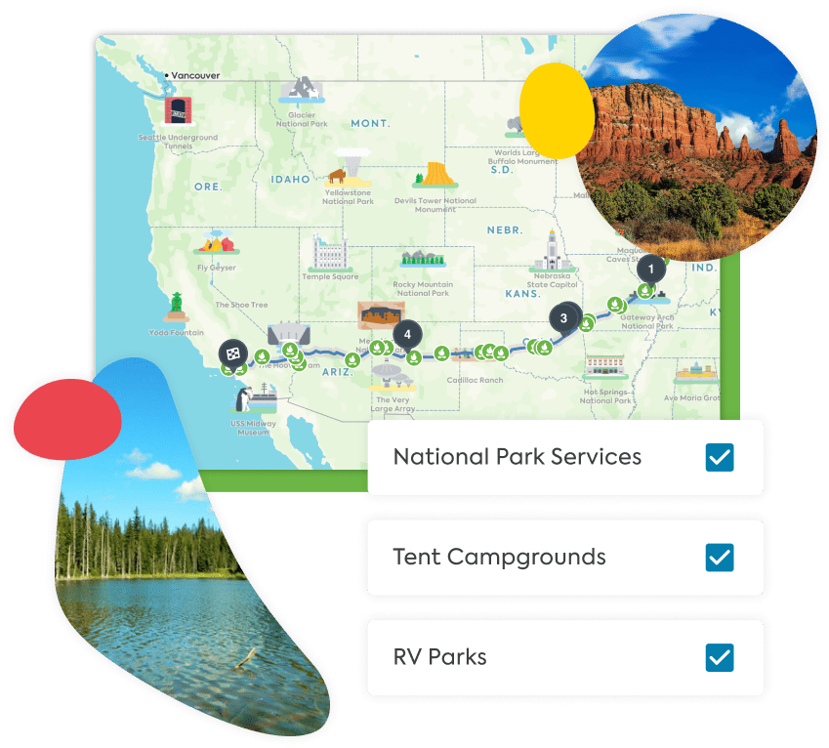
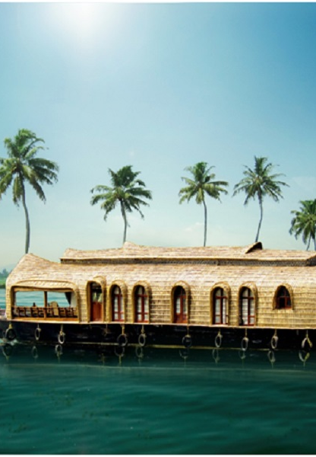

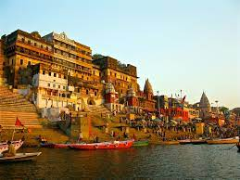

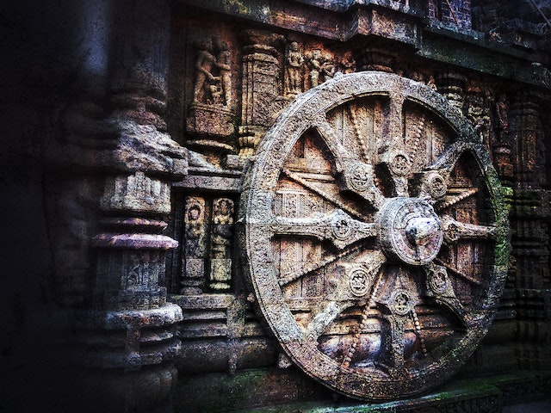
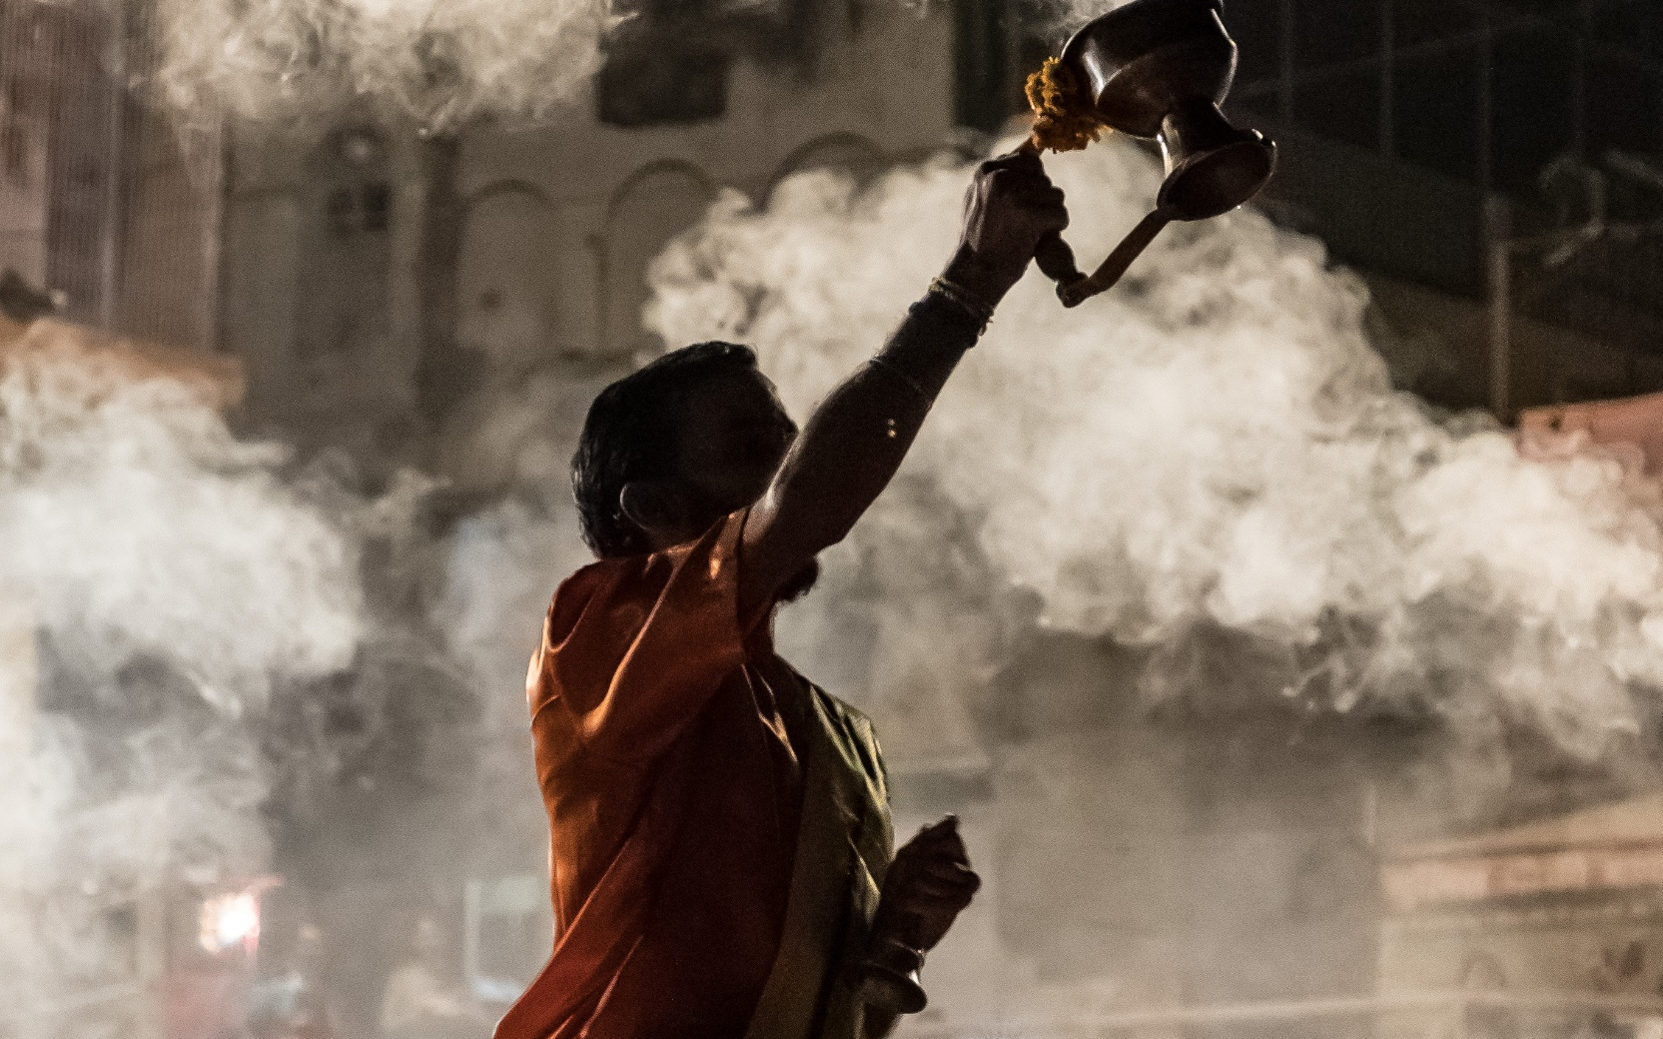
Honeymoon packages theme
Trip planner
wedding
Honeymoon blog theme
Charoite in sun temple
Varanasi temple
Ganga harathi
Himalayas

Slide 19
Internal link building
When it is coming to internal link building there few tried and tested methods for boost our SEO strategy
Anchor text: by using anchor text method we can link between pages in website and our old blogs by inserting links keywords in a meaningful manner. With this we can insert links of our services in that services related blogs and vice versa.
Bread crumbs: Breadcrumbs are a great way to make it easy for visitors to navigate through your website. They also provide an opportunity for internal linking, as each page in the breadcrumb can be linked to.
Interlinking categories and services: with this method we can link multiple categories or services or sections of our website, consider adding internal links between them. This will help visitors quickly find related content and boost the SEO of each individual page.
By using above methods we can link internally our services page and blog page
For example:
If a visitor of our website is interested in finding best destination for honeymoon and he landed in our top 10 honeymoon destinations in india and he choose to visit Goa in that case we can insert our goa honeymoon packages link in that particular keyword in which visitor is interested Here is the top honeymoon destination in goa in this highlighted keyword we can insert the link of goa honeymoon packages page link as https://www.skyasiatours.com/packages/honeymoon/goa

Slide 20
Press release
Press release is the one of the most important aspect of off page SEO. It enables us to drive more traffic to our website by creating brand awareness about our niche.
Press releases can be used to promote new products and services, announce special events, and provide updates on your business. They are also a great way to generate backlinks, which are essential for SEO.
When we do press release our article is picked by various news publisher and content creators by this way we can create more back links to our website.
For doing press release for our business I picked top PR websites which having great potential to create quality back inks for our website
https://www.npr.org/ : DA 93 PA 80 Do follow no
http://www.prweb.com/ : DA 92 PA 72 Do follow yes
https://www.mediapost.com/ : DA 93 PA 80 Do follow yes
The reason for choosing above listed 3 websites
1. those websites domain authority and page authority is very high and having great potential to create very high quality back inks for our website which is very critical to drive more traffic to our website
2. this websites are allowing us to publish our business articles free of cost on their platforms
3 PR web and mediapost websites are providing free do follow back links to our website with high domain authority. NPR.ORG is not providing do follow link but there website authority is very high with the 53 million monthly visitors

Slide 21
Guest Blogging
Guest blogging is an important part of SEO, like Press release it is also helps us to build backlinks to our website and increase our website’s visibility. When we guest blog, we are also creating back links to our website from another website, which helps us to rank higher in search engine results. Additionally, guest blogging can help us to increase our website’s reputation, as the quality of our content is reflected in the blogs that we are writing. Finally, guest blogging can help to build relationships with other bloggers and websites, which can lead to further opportunities.
To promote our website through guest blogging I selected these two websites as follows
1. https://www.travelandleisure.com
2. https://www.outlookindia.com
These two websites are highly rated top travel magazines in India, these websites having 37 million and 11 million monthly average visitor
And maintaining very high domain and page authority. If we can manage to do guest blogging in there websites we can expect good amount of conversion traffic from there domain to our website

Slide 22
INBOUND LINKS
Inbound links from other websites to our website is important for a number of reasons
Firstly, Inbound links are a signal to search engines that our website is an authority in user search intent and has content that is worth linking to
In addition, they can drive more traffic to our website, as visitors will often click on links that they find when browsing other websites and Inbound links also help boost your website’s rankings in search engine results pages, which can lead to more organic traffic.
Finally, inbound links can help to build relationships with other websites, as they are seen as a form of endorsement.
List of prominent websites that we can get inbound links to promote our content to there website visitors
1. PAYTM
Paytm is a digital wallet and online payment system that offers a wide range of services in the travel niche. With Paytm, users can book flight tickets, hotels, bus tickets, and car rentals, and manage their bookings. They can also pay for tolls, parking fees, and other travel-related expenses. Additionally, users can purchase travel insurance policies and check-in for flights. Paytm also offers exclusive discounts and special offers for travelers.

Slide 23
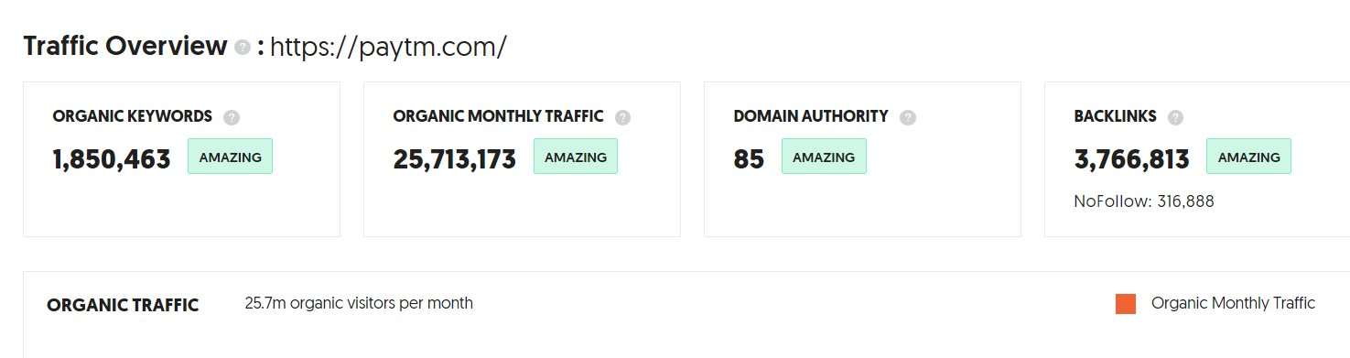
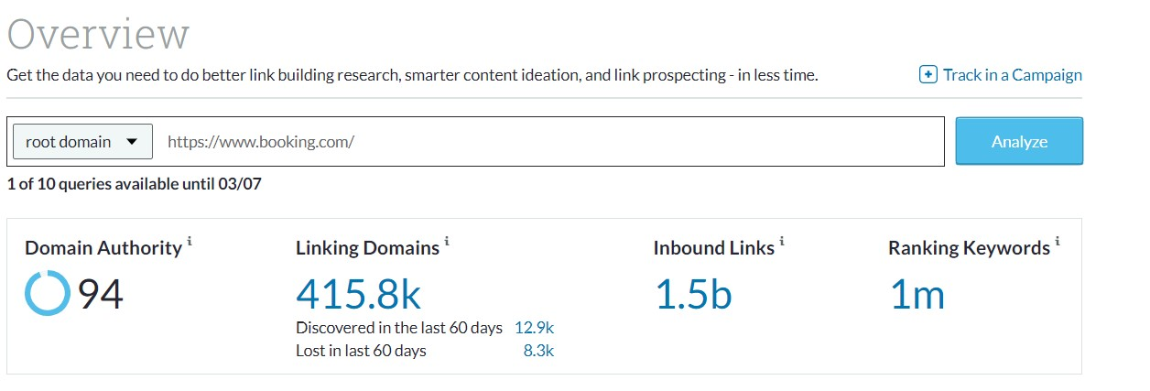
Booking.com
Booking.com is a leading global online travel accommodation services provider, enabling travelers to search and book a wide range of accommodations, ranging from hotels, apartments, villas, and hostels. With a mission to provide travelers with the most comprehensive selection of accommodations and world-class customer service, Booking.com has become one of the leading online travel services providers, offering over 1.5 million accommodations in more than 227 countries and territories worldwide.

Slide 24
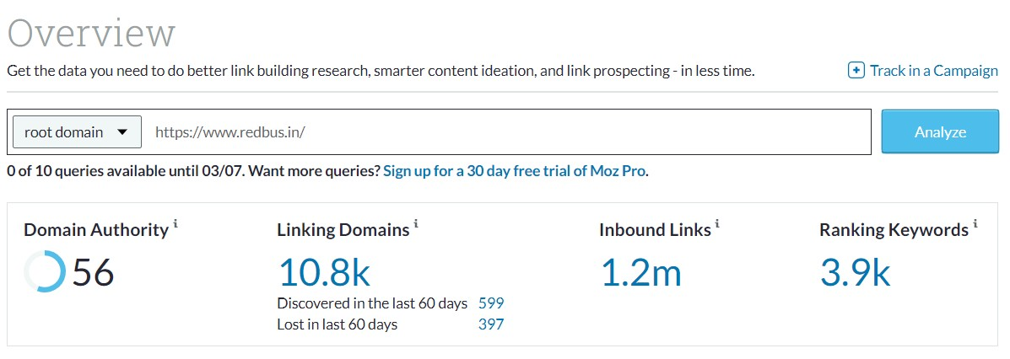
REDBUS.COM
RedBus is an online bus ticketing platform that provides bus tickets for inter-city and intra-city travel. The platform provides a convenient and easy way to book bus tickets online and helps travelers save time and money. RedBus offers a wide range of services to travelers, including seat selection, online ticket booking, payment options, and discounts. Additionally, the platform provides real-time updates on bus arrival and departure times, so travelers can plan their trips accordingly. RedBus is committed to providing a safe and secure travel experience for its customers.

Slide 25
Thank you

